Slide 1
LINQ in C#

Slide 2
What is LINQ
Language-Integrated Query (LINQ) is the name for a set of technologies based on the integration of query capabilities directly into the C# language. Traditionally, queries against data are expressed as simple strings without type checking at compile time or IntelliSense support. Furthermore, you have to learn a different query language for each type of data source: SQL databases, XML documents, various Web services, and so on.

Slide 3
LINQ operators
Where, OrderBy, ThenBy, GroupBy, Join, Select, All, Any, Contains, Aggregate, Average, Count, Max, Sum, First, FirstOrDefault, Last, LastOrDefault, Concat, Empty, Range, Rapit, Distinct, Except, Union, Intersect, Skip, SkipWhile, Take, TakeWhile e.t.c.

Slide 4
Query syntax
Query syntax is similar to SQL for the databases.
It is defined within C#
Query Syntax stars with from clause and ends with Select or groupBy.

Slide 5
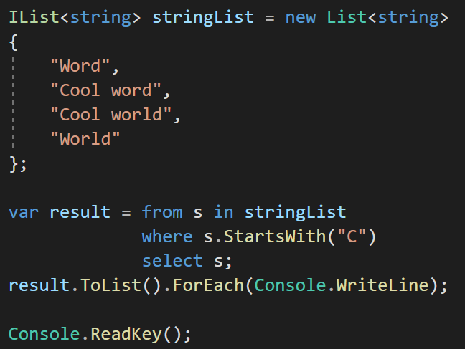
LINQ query syntax example
Output:
Cool word
Cool world

Slide 6
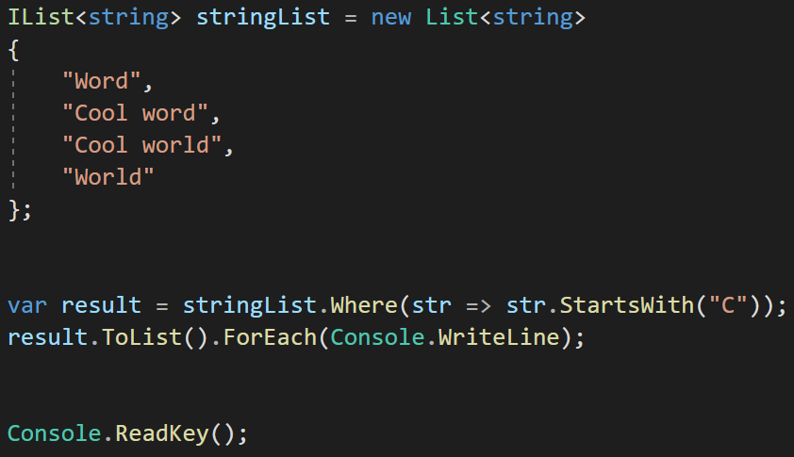
LINQ method syntax example
Output:
Cool word
Cool world

Slide 7
Examples

